Slide 1

Notes:
The WHO, the UN and the World Economic Forum all name antibiotic resistance as one of the most serious threats to global health. That line opens the Tyks challenge brief. Here is what it looks like on one ward, on one Monday.

Slide 2
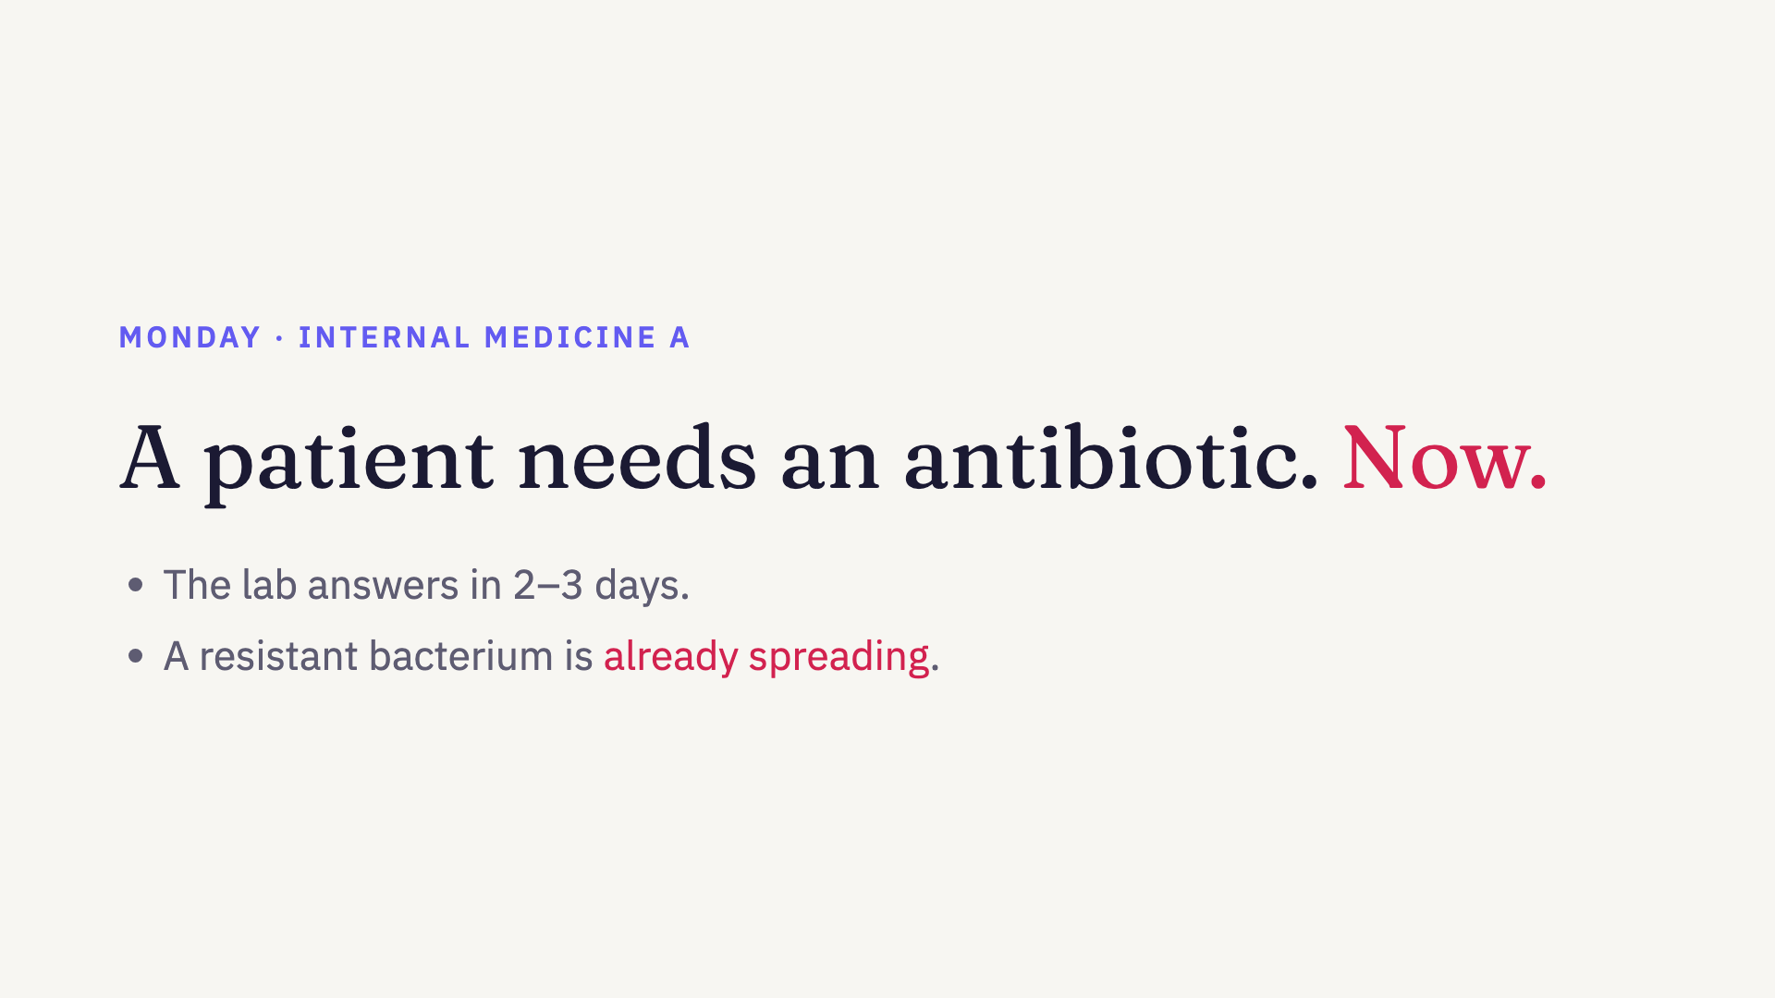
Notes:
Monday morning, Internal medicine A at Tyks. A patient comes in with a urinary infection. The doctor has to start an antibiotic now. The lab will tell us which bacterium it is and what it resists, but that takes two to three days. So the first antibiotic is an educated guess. And on this very ward, a bacterium that resists many common antibiotics is spreading from patient to patient. Nobody has noticed yet.

Slide 3

Notes:
The same week, a researcher at the lab sees resistance creeping up and asks the obvious question: is this rise real, or just noise? To answer it today, they export the data, clean it, count first isolates by hand and run the statistics in a spreadsheet. That takes weeks, and by then the question has moved on.

Slide 4
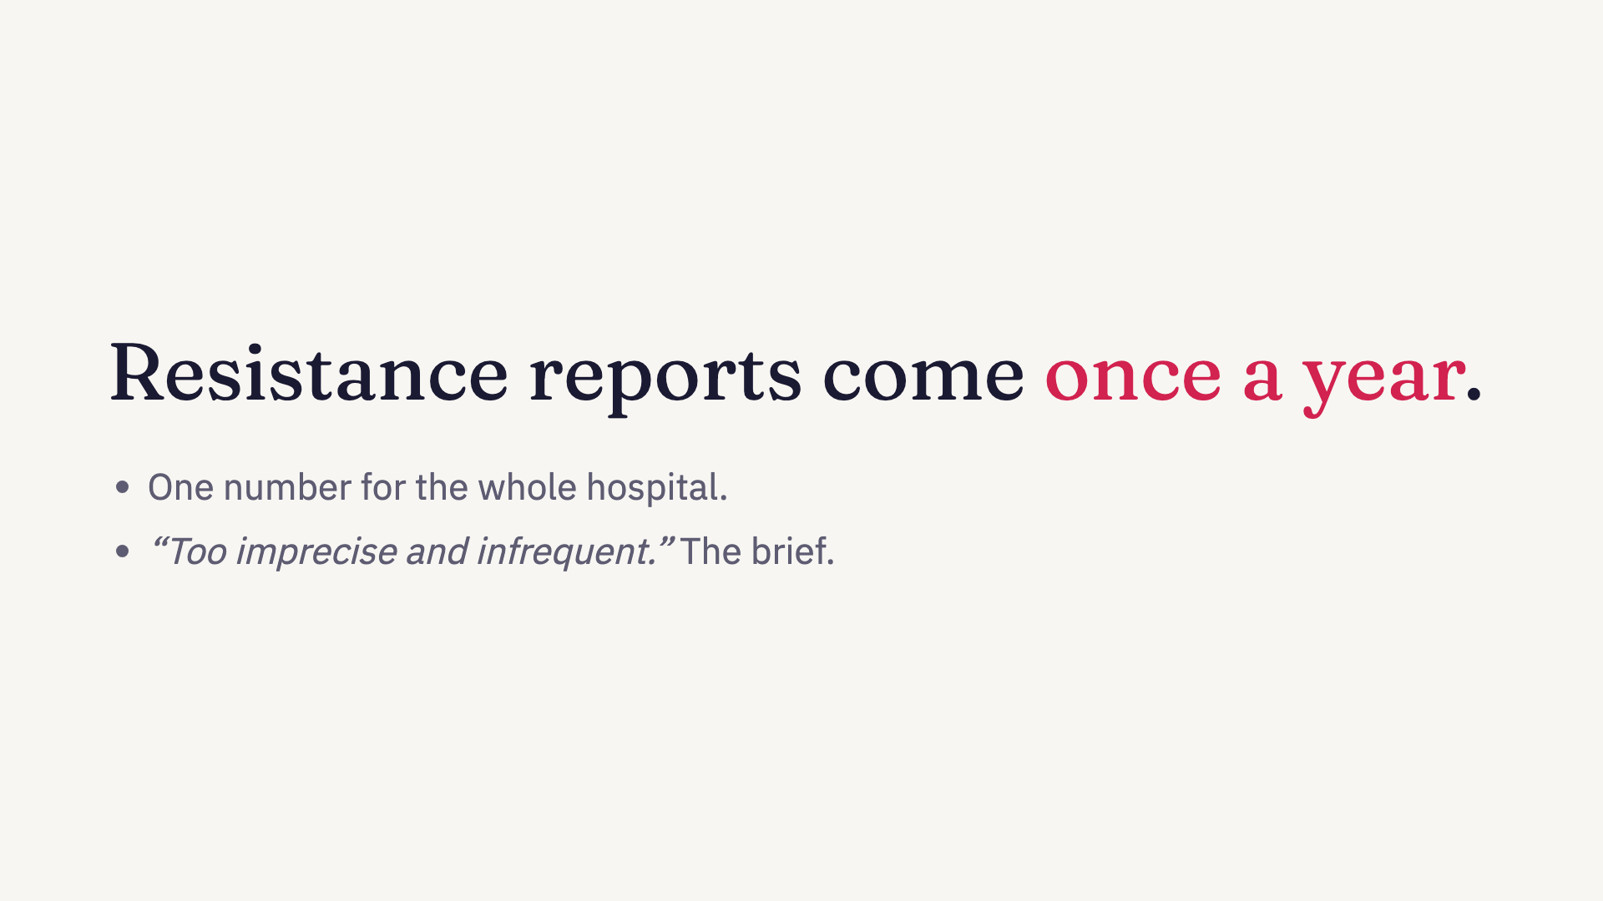
Notes:
What is the doctor’s guess based on? The resistance report. Tyks compiles it once a year, at hospital level. In the words of the challenge brief, too imprecise and infrequent. It cannot say what works on this ward this month, and it cannot see the bacterium spreading here right now.

Slide 5
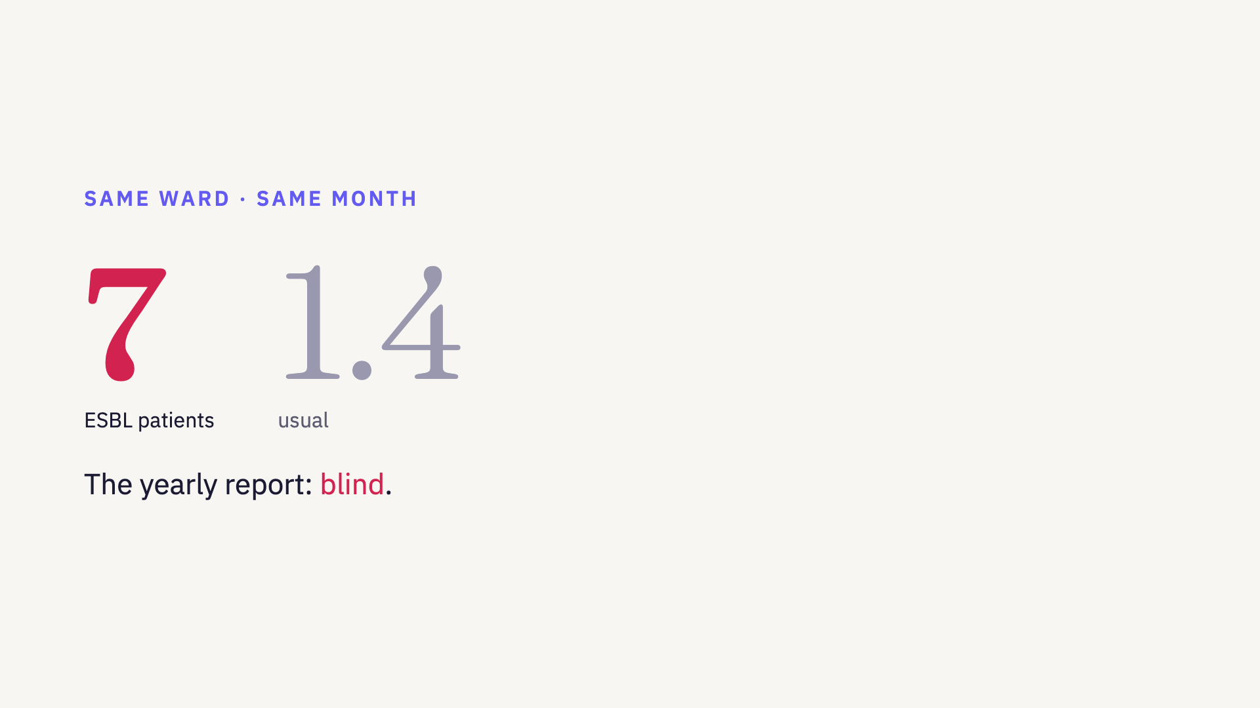
Notes:
And something is happening. On this same ward, seven patients have grown ESBL bacteria, the kind most common antibiotics fail against. Usual is 1.4. That is a cluster, maybe spreading from bed to bed. In a yearly hospital-wide average, seven patients on one ward disappear. That is why we built agar.

Slide 6

Notes:
agar. The right antibiotic for doctors, live alerts for infection control, and a notebook that does the statistics for researchers. One live feed of lab results behind all three.

Slide 7
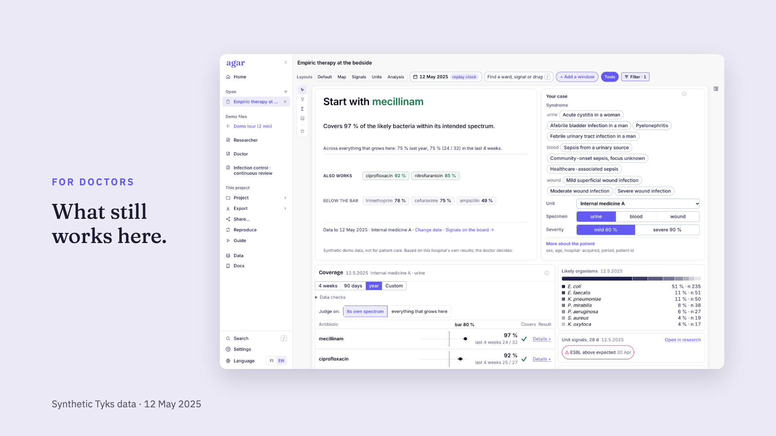
Notes:
This is agar on that Monday morning. The doctor picks the ward, the specimen and how severe the infection is. agar answers: start with mecillinam, it covers 97 percent of the likely bacteria on this ward, with ciprofloxacin and nitrofurantoin as alternatives. Every number shows the last four weeks next to the whole year, and how many patients it rests on.

Slide 8
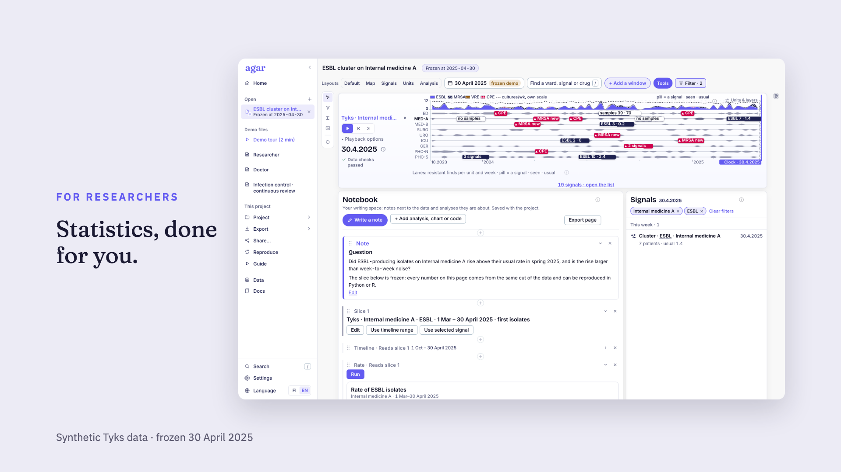
Notes:
And the same cluster, seen by a researcher. The project is frozen on 30 April, so every number stays the same while the paper is written. The question, the slice of data and each analysis sit in one notebook, and every result comes with the Python or R code to reproduce it, and exports in one click.

Slide 9

Notes:
Play the two-minute film here. Don’t talk over it.

Slide 10
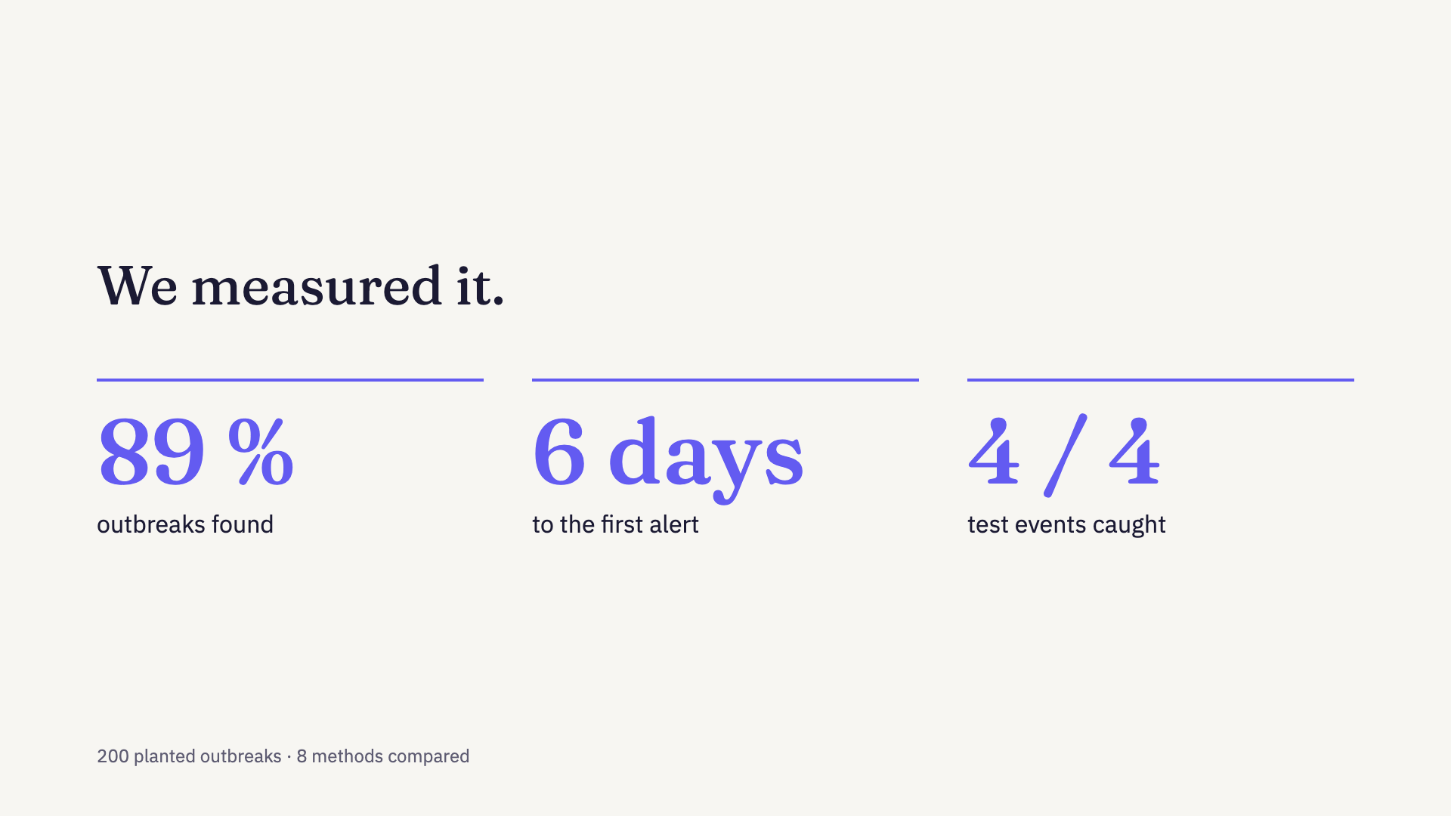
Notes:
An alert is only useful if you can trust it, so we measured ours. We planted 200 outbreaks of four patients into the three years of data. agar found 89 percent of them, a median of six days after the first case, at about four and a half alerts a year. We compared it with eight methods from the surveillance literature, and none of them beat it by the criteria we set before testing. All four test events in the data were caught, the ICU MRSA on day zero.

Slide 11
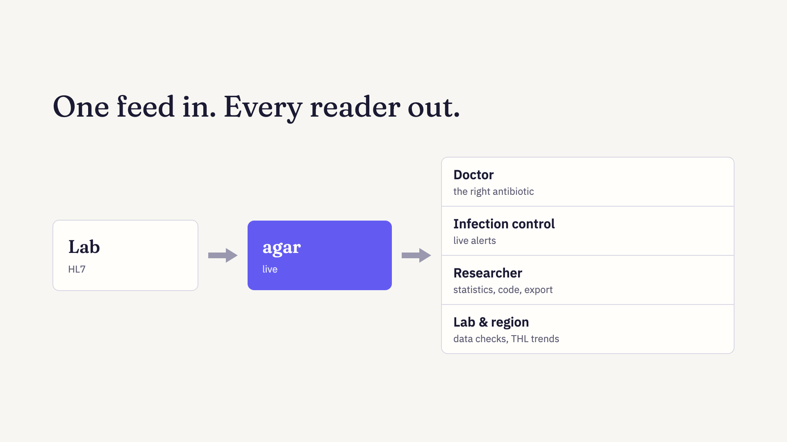
Notes:
One feed goes in: the lab results, as HL7, the format the laboratory system already sends. Out of the same numbers come answers for everyone who acts on them. The doctor gets the right first antibiotic for this ward. Infection control gets clusters flagged, and the next step is sending them straight into their worklist. Researchers freeze a project at a date so the numbers never move under a paper, and export the data with R, Python and LaTeX methods to reproduce it. And the lab gets data checks on every batch, linked to THL’s regional trends.

Slide 12

Notes:
A once-a-year report cannot keep up with bacteria that spread in days. agar gives every ward its own answer, every day, and tells you when something is wrong. Speed is a treatment. Thank you.

Slide 13

Notes:
Introduce the team.

